Slide 1
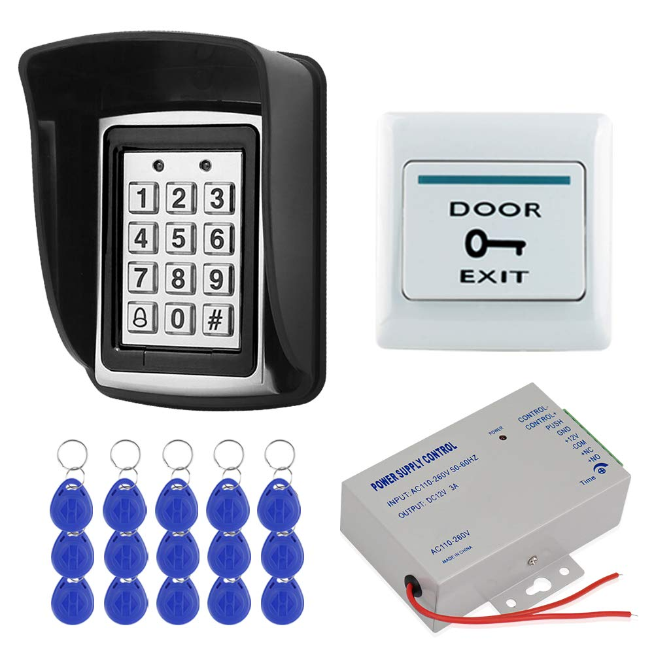
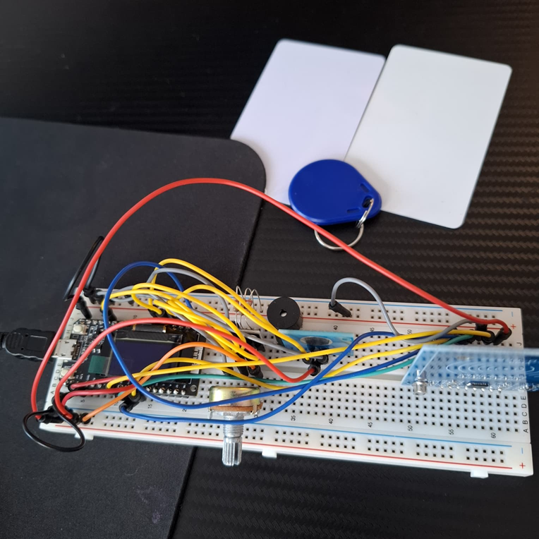
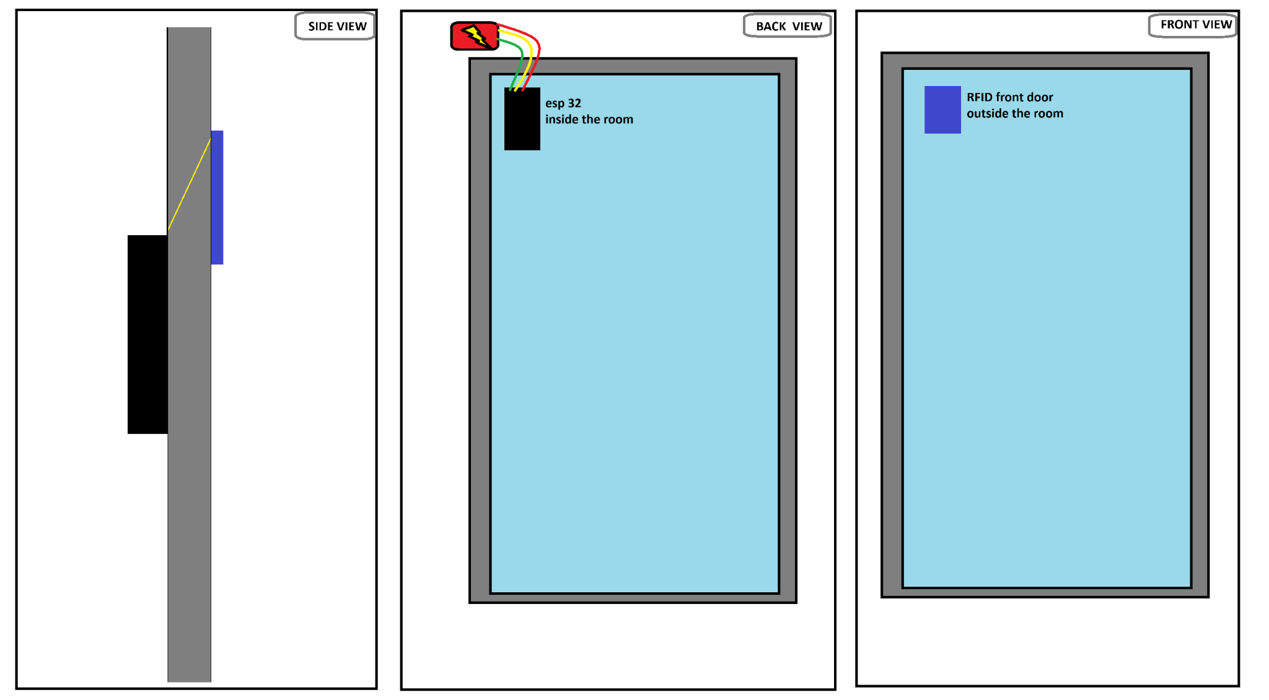
Title Slide: SOEN422 RFID Access Control System
SOEN422 Final Presentation
Project: RFID Access Control System
Student ID: 40256377
Name: Yahya Belgharbi
Email: y_belgha@concordia.ca
GitHub: github.com/Silent0Wings

Slide 2
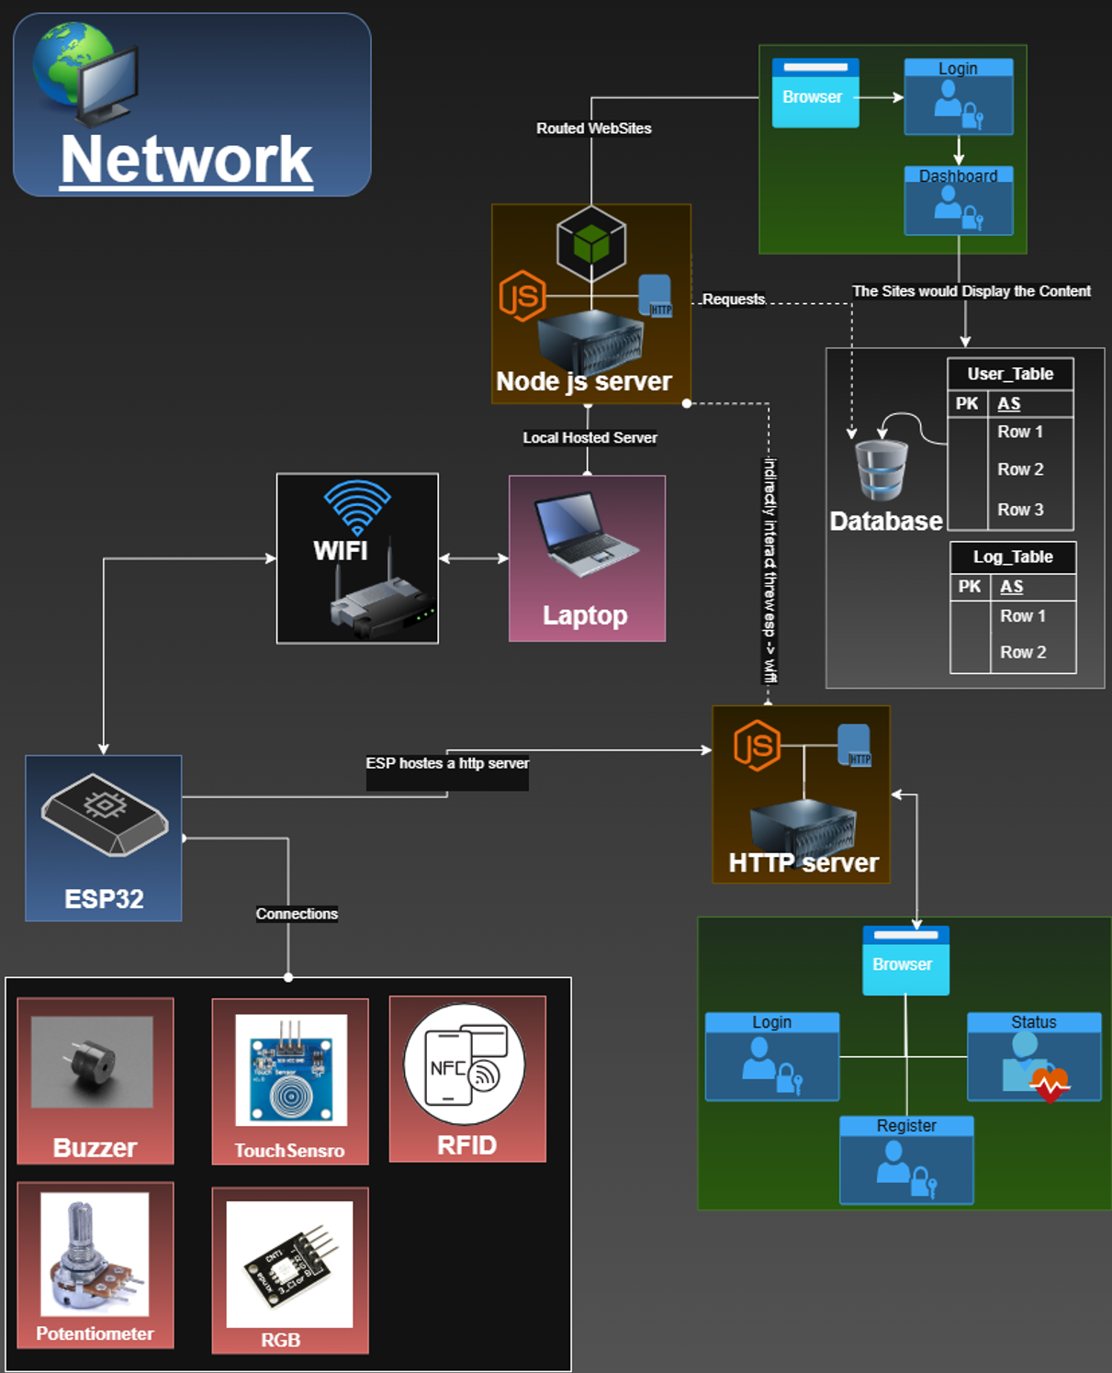
Project Context and Overview
Purpose: The RFID Access Control System project was developed as part of the SOEN422 course to demonstrate understanding and application of software engineering principles.
Design and implement a secure access control system using RFID technology.
Integrate hardware and software components effectively.
Adhere to software engineering best practices throughout the development process.
Demonstrate a functional and reliable system.

Slide 3
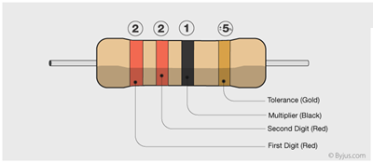
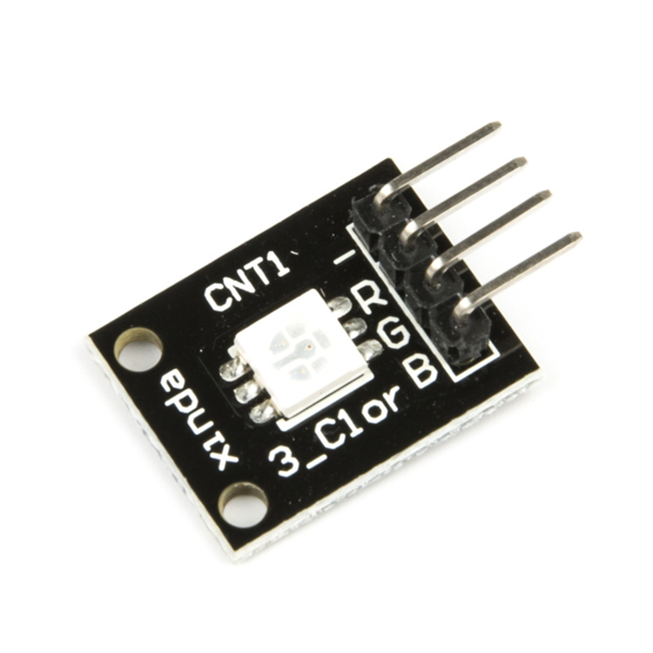
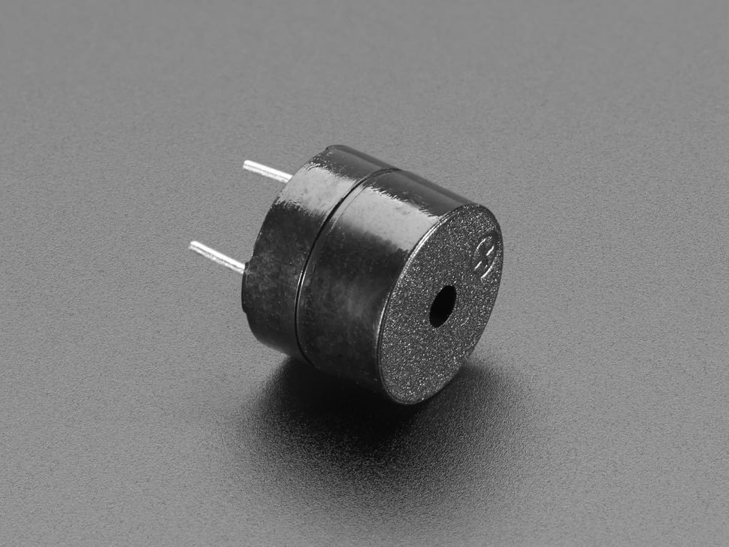
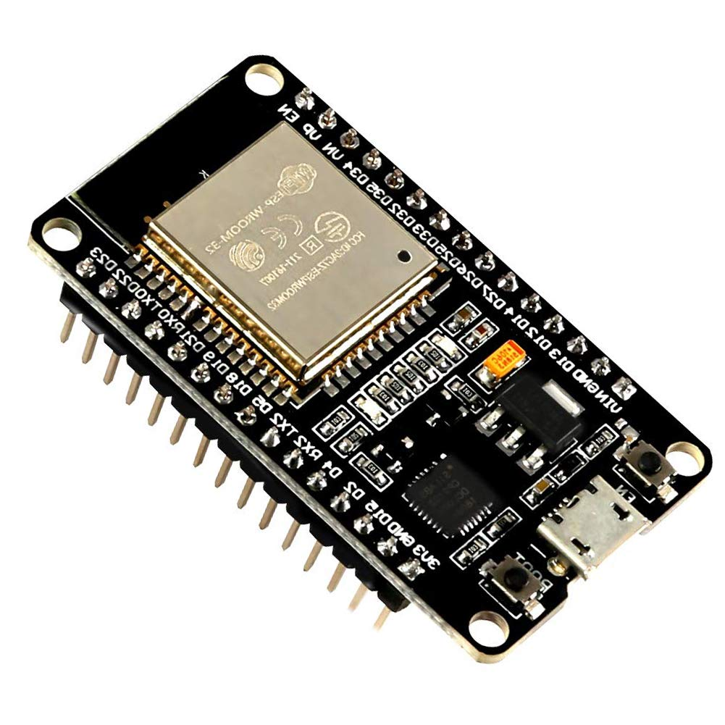
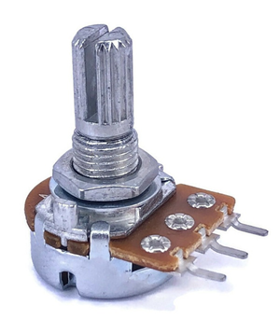
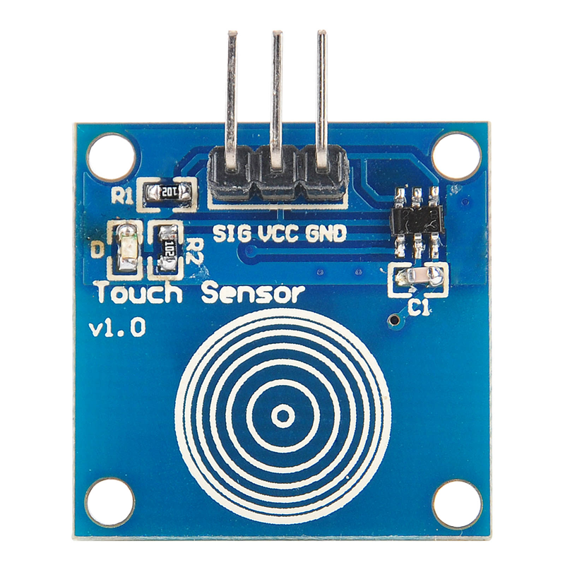
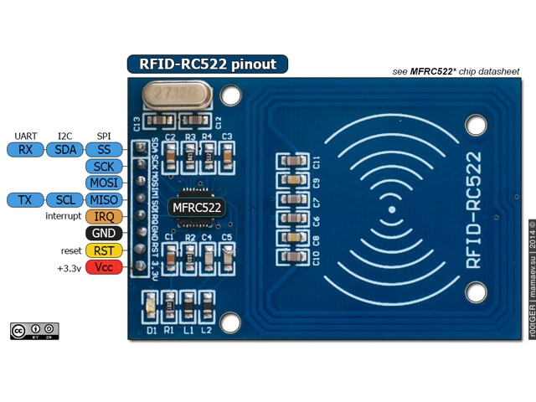
System Architecture and Technology Stack
System Architecture: The system comprises several key components:
RFID Reader for tag detection.
ESP32 microcontroller for processing and control.
Backend server for data management and validation.
Web UI for user management and system configuration. (Placeholder for: ESP32_Access_System_Architecture.png)
Technology Stack:
Microcontroller: ESP32
Programming Language: C++ (Firmware), JavaScript (Web UI)
Backend: Node.js with Express
Database: MongoDB
Communication Protocol: HTTP (Placeholder for: tech_stack.drawio.png)

Slide 4
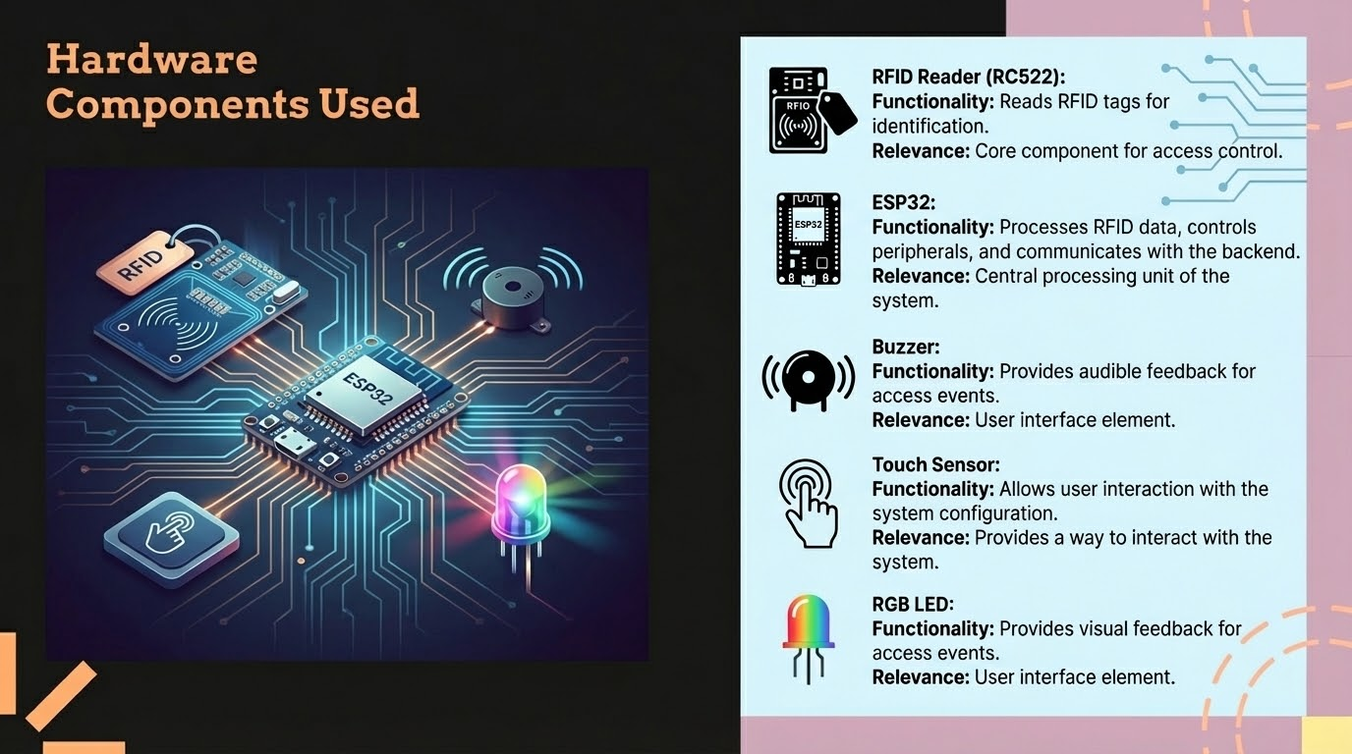

Slide 5

Project Planning and Execution
Planning Phase:
Defined project scope, objectives, and deliverables.
Created a detailed project timeline with milestones.
Allocated tasks and responsibilities within the team.
Execution Process:
Implemented modular design for maintainability.
Conducted regular code reviews and testing.
Utilized version control (Git) for collaboration.
Followed Agile methodologies for iterative development.

Slide 6
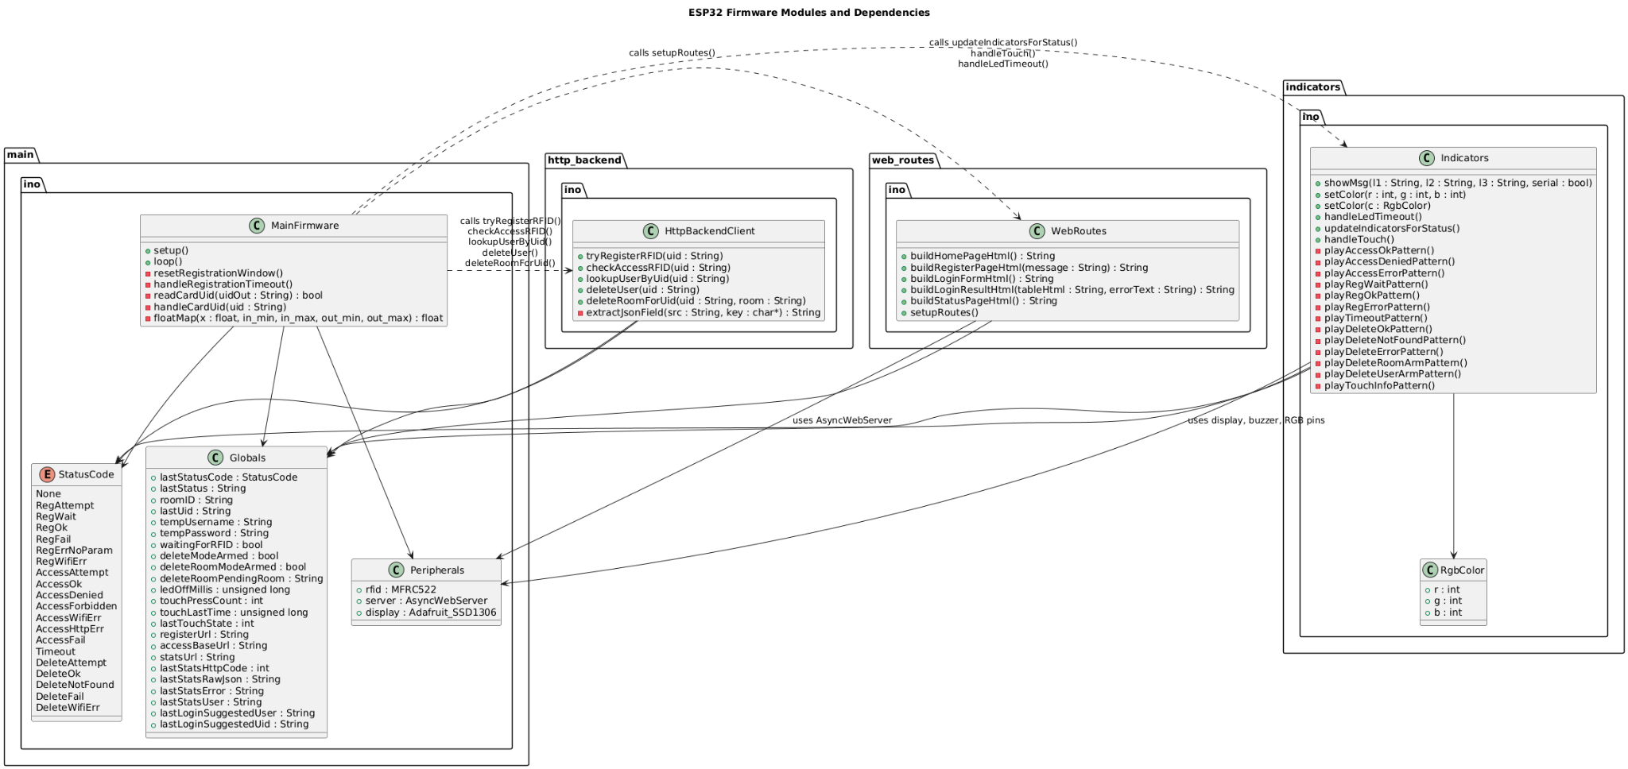
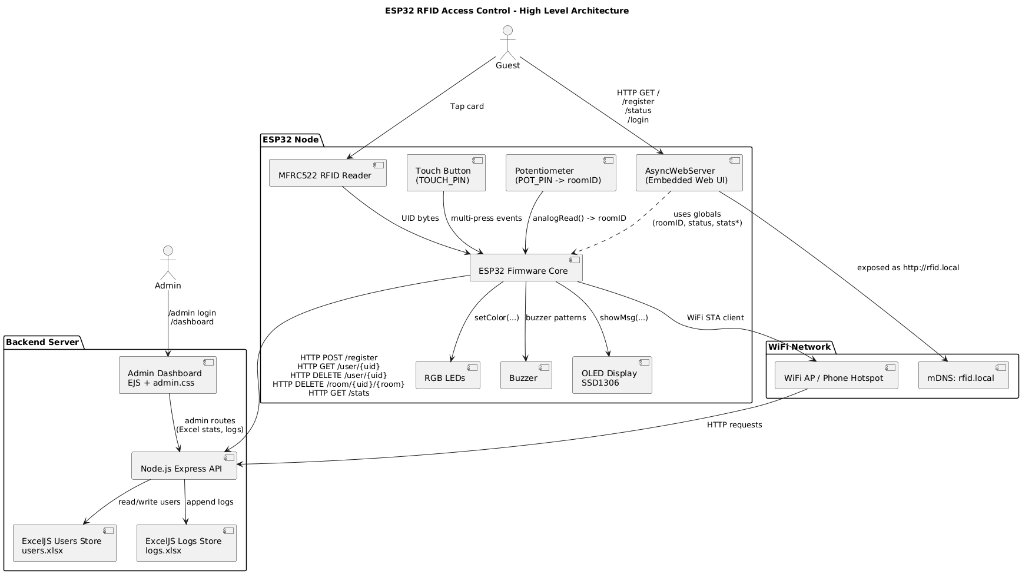
Technical Depth and Organization
Technical Complexity
Organizational Structure
The project demonstrates technical depth through the integration of various technologies and complex algorithms.
The project is organized into logical modules, promoting clarity and coherence. The firmware modules are well-structured, and the code is well-documented and follows coding standards.

Slide 7
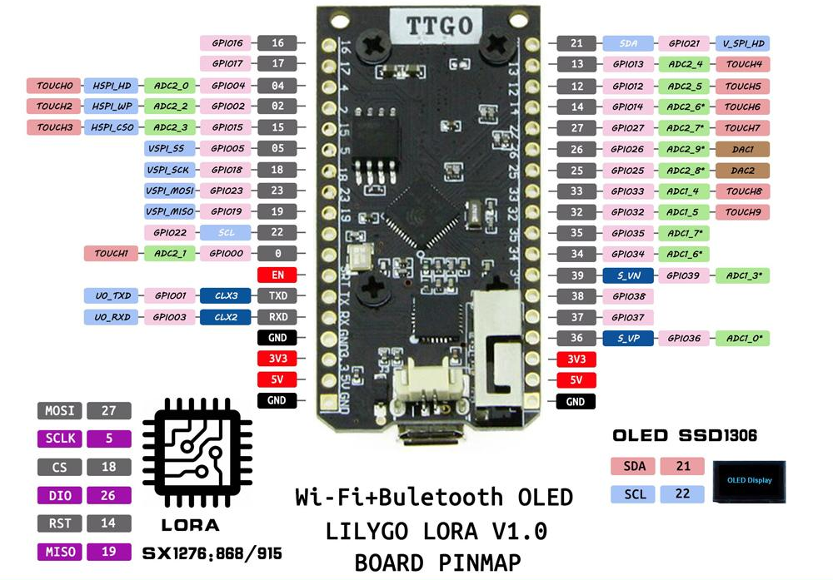
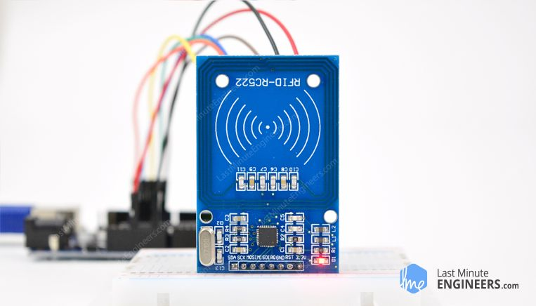
Hardware Quality and GPIO Mapping
Hardware Evaluation
The hardware components were selected for their reliability and performance.
GPIO Mapping
Proper GPIO mapping is crucial for the correct functioning of the system. Accurate GPIO mapping ensures seamless communication between the ESP32 and peripheral devices. The RFID Reader uses the SPI interface, the Buzzer is a digital output pin, the Touch Sensor is a digital input pin, and the RGB LED uses multiple digital output pins.

Slide 8
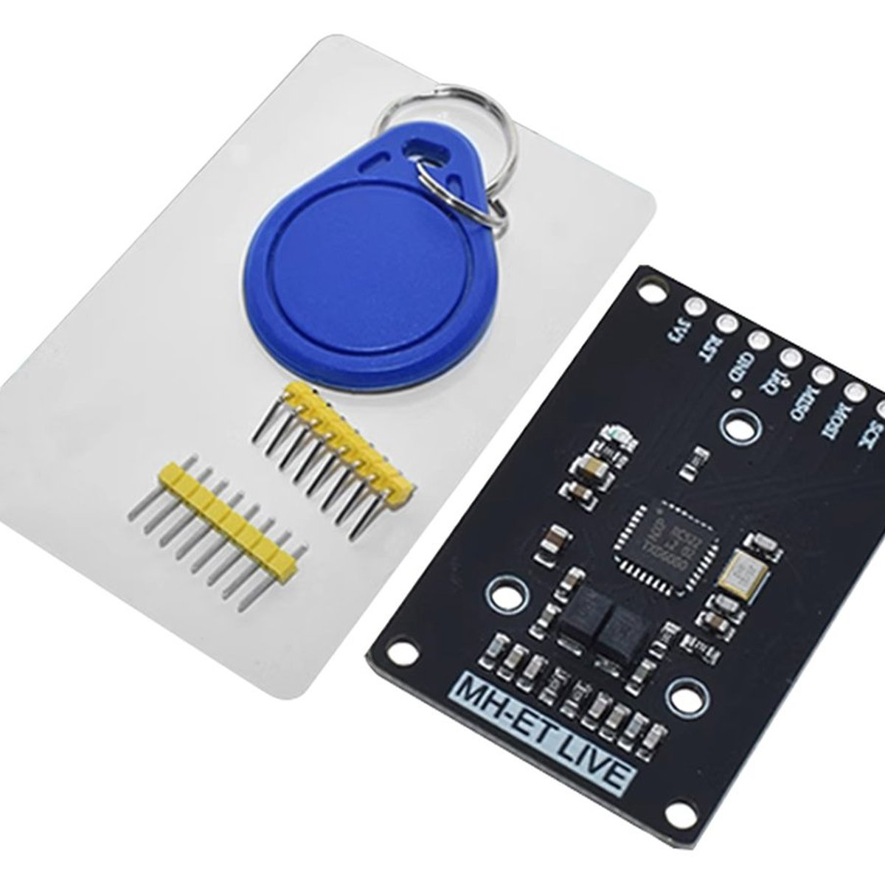
Hardware Components Used
RFID Reader (RC522):
Functionality: Reads RFID tags for identification.
Relevance: Core component for access control. (Placeholder for: rc522-full_RFID_Reader.jpg)
ESP32:
Functionality: Processes RFID data, controls peripherals, and communicates with the backend.
Relevance: Central processing unit of the system. (Placeholder for: The Wi-Fi + Bluetooth OLED esp ttgo LILYGO LORA V1.0.jpg)
Buzzer:
Functionality: Provides audible feedback for access events.
Relevance: User interface element. (Placeholder for: Normal_Buzzer.jpg)
Touch Sensor:
Functionality: Allows user interaction for system configuration.
Relevance: Provides a way to interact with the system. (Placeholder for: TOUCH SENSOR V1.0.png)
RGB LED:
Functionality: Provides visual feedback for access events.
Relevance: User interface element. (Placeholder for: RGB 3_COLOR CNT1.png)

Slide 9

Quality of the Implementation
Best Practices Followed:
Modular design for maintainability and scalability.
Code documentation for clarity and understanding.
Version control (Git) for collaboration and tracking changes.
Regular code reviews for quality assurance.
Thorough testing to ensure reliability and functionality.

Slide 10
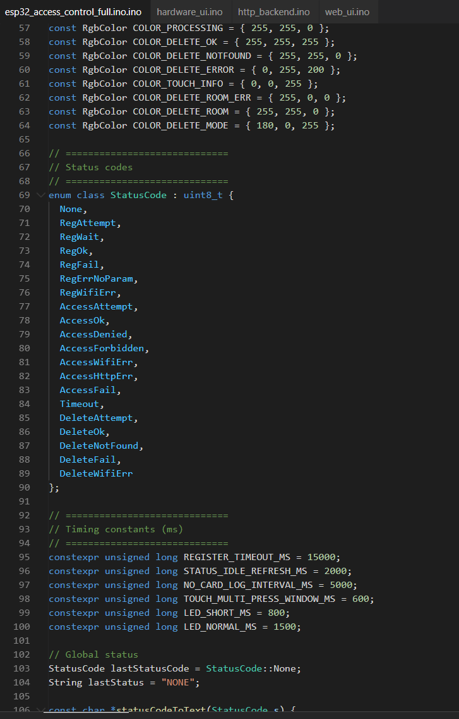
Neatness, Visual Design, and Organization
Visual Aspects:
The project exhibits a clean and organized layout.
The code is well-formatted and easy to read.
Systemic Organization:
The project follows a logical structure, making it easy to navigate and understand.
Web UI Routing (Placeholder for: Web UI Routing.png)

Slide 11
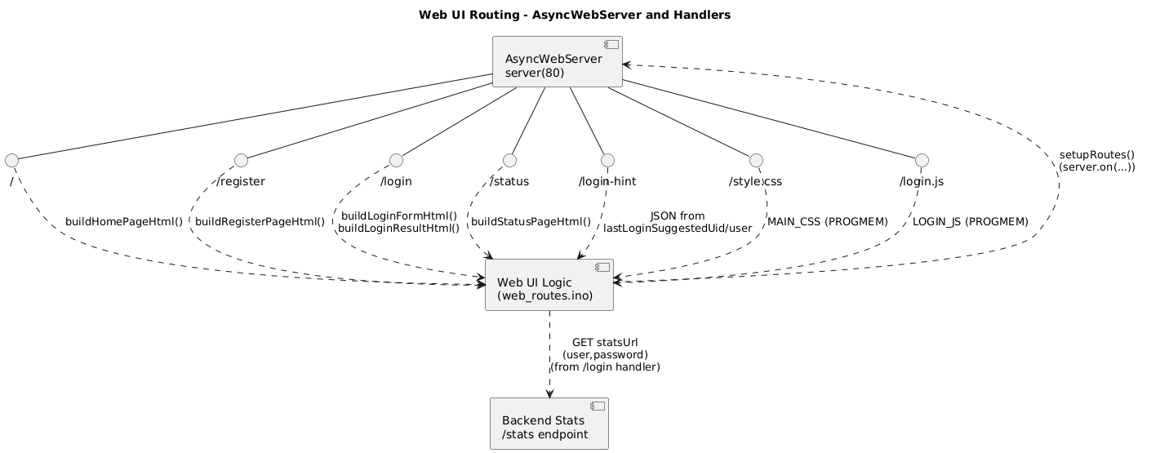
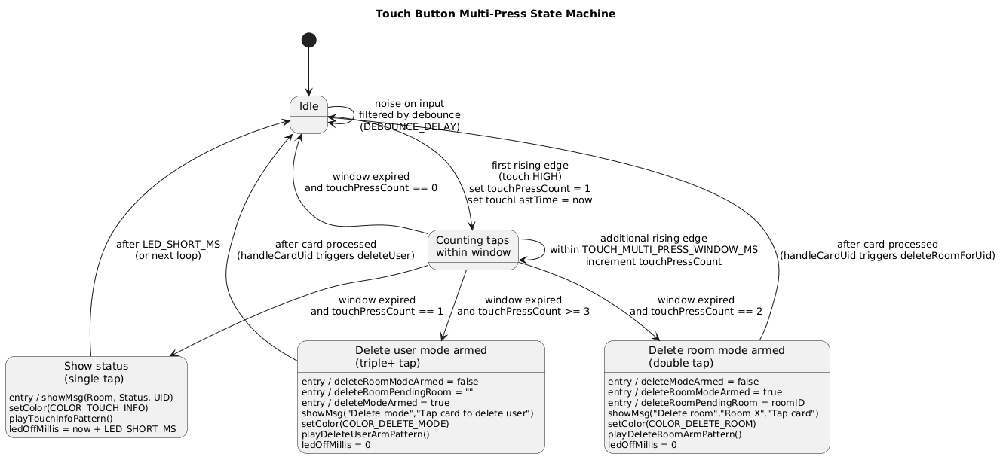
Effectiveness, Completion, and Demonstration Flow
Project Effectiveness: The RFID Access Control System effectively demonstrates the core concepts of access control.
Completion: All project objectives were successfully achieved.
Demonstration Flow:
System setup and configuration (Placeholder for: Setup.png).
RFID tag registration (Placeholder for: RFID Registration Flow.png).
Access validation (Placeholder for: RFID Access Validation Flow.png).
HTTP Backend Interactions (Placeholder for: HTTP Backend Interactions.png).
Indicator State Machine (Placeholder for: Indicator State Machine.png).
Touch Button Multi-Press State Machine (Placeholder for: Touch Button Multi-Press State Machine.png).

Slide 12
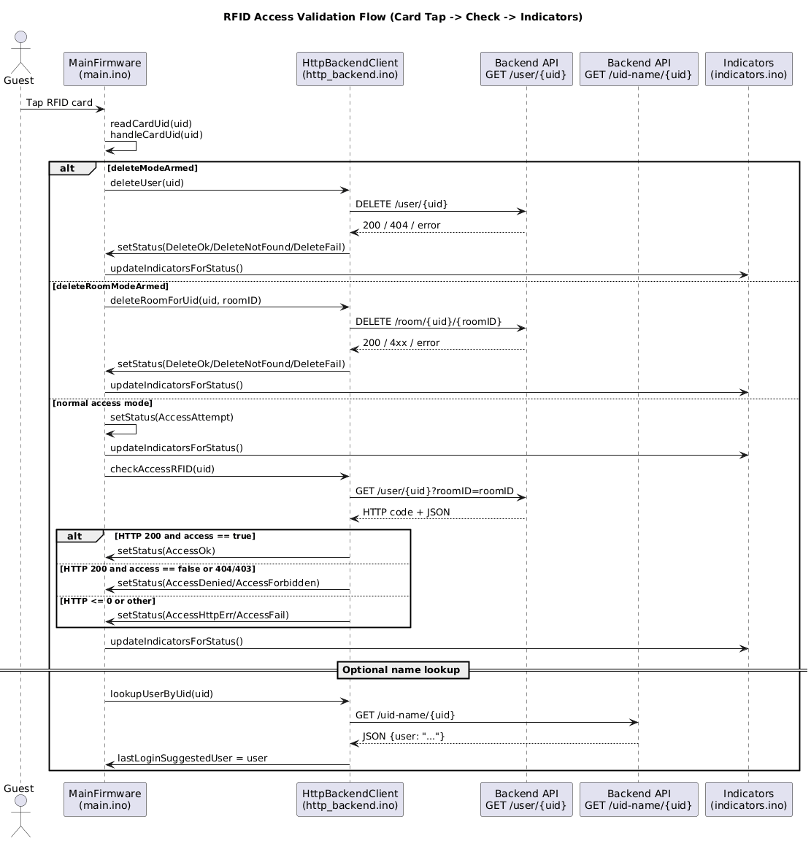
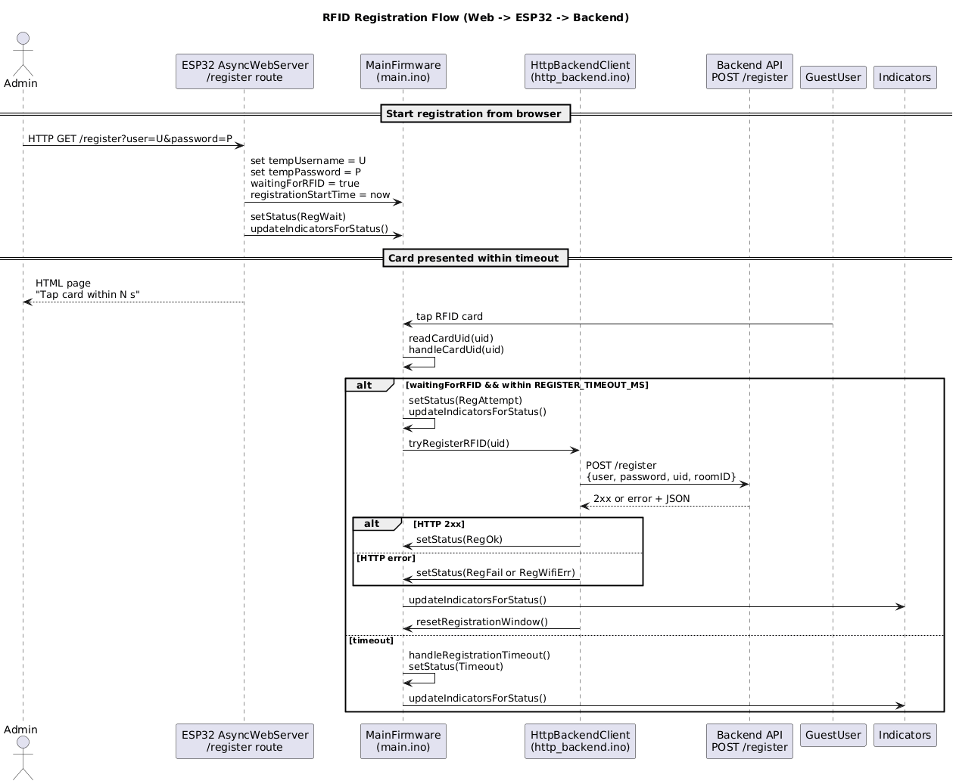
Sequence Diagrams Access / Registration

Slide 13
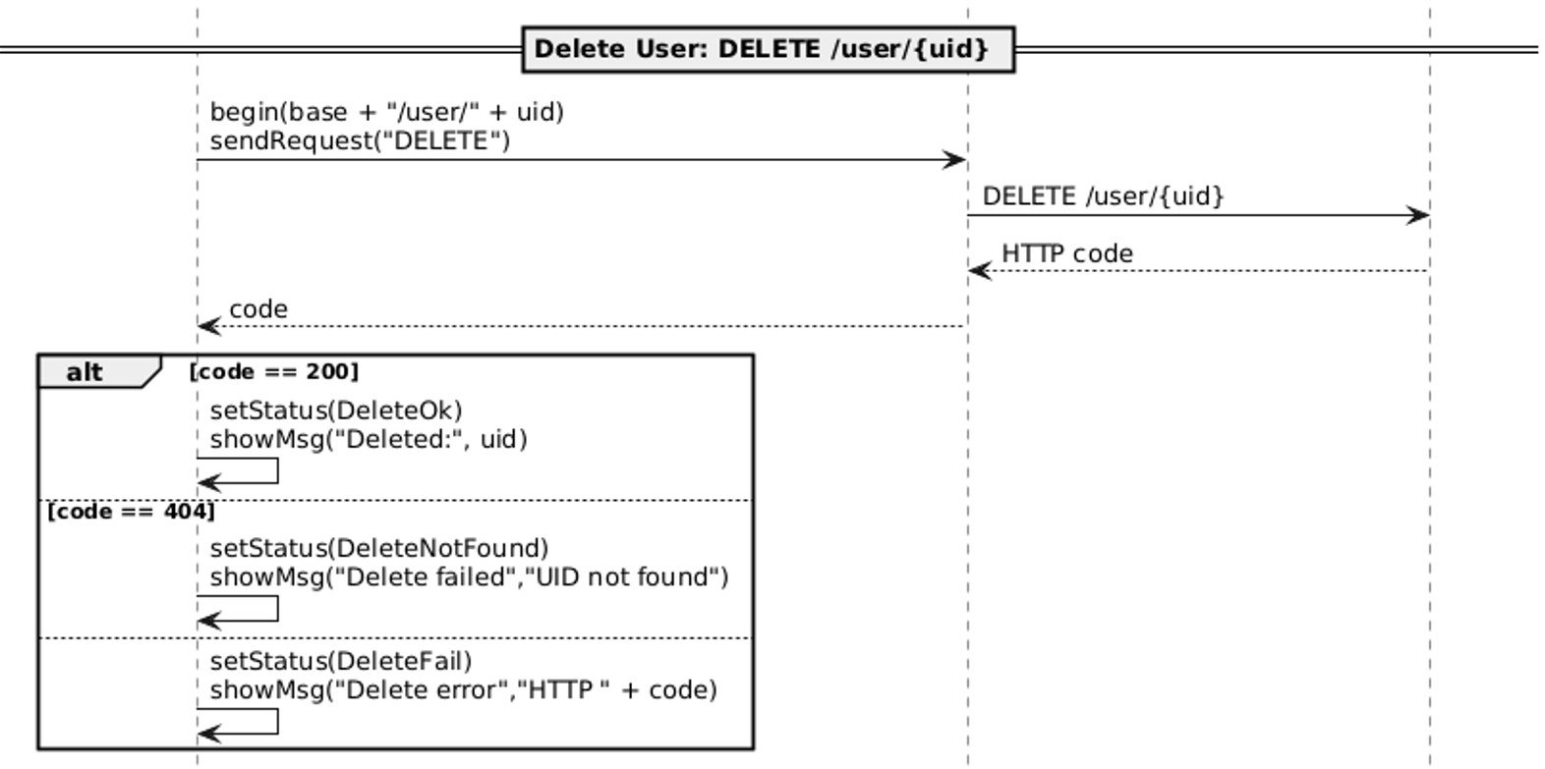
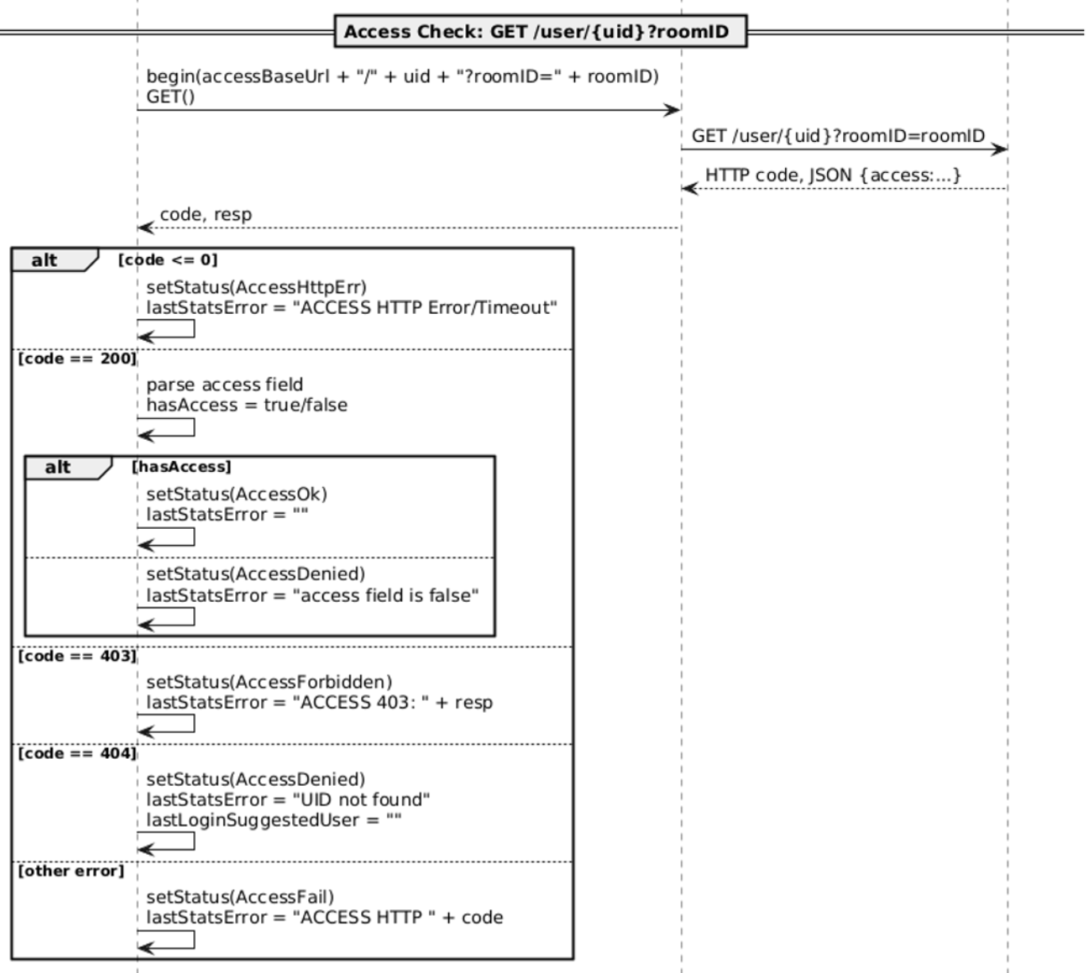
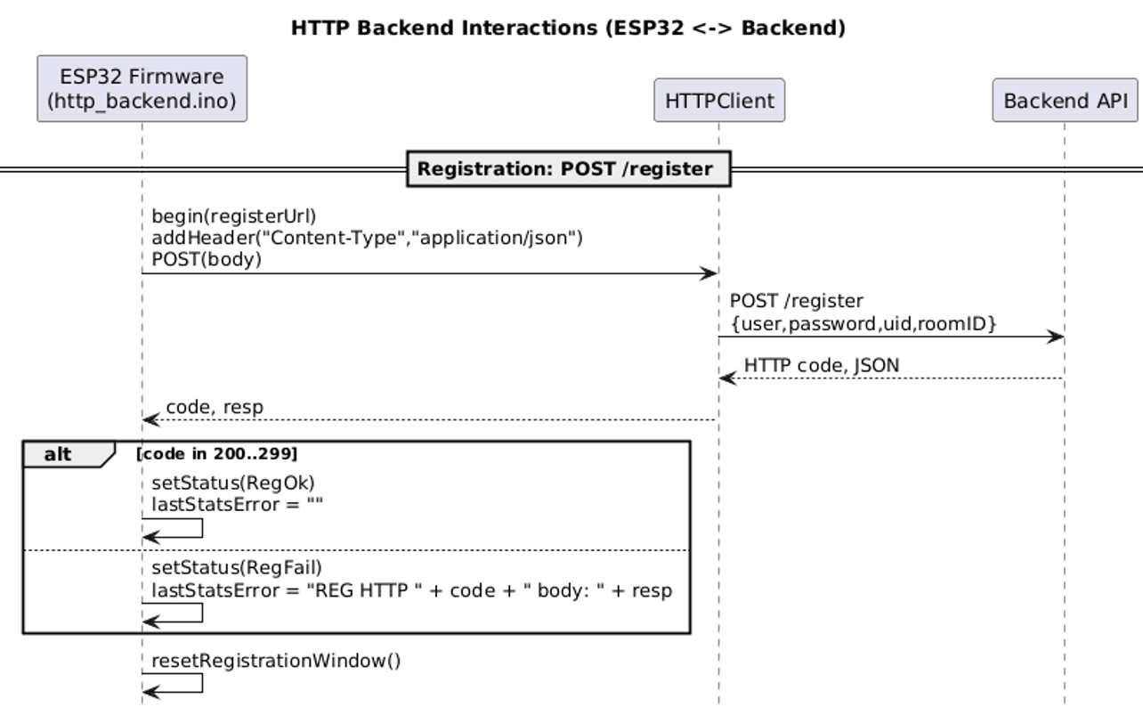
HTTP Backend Interactions

Slide 14
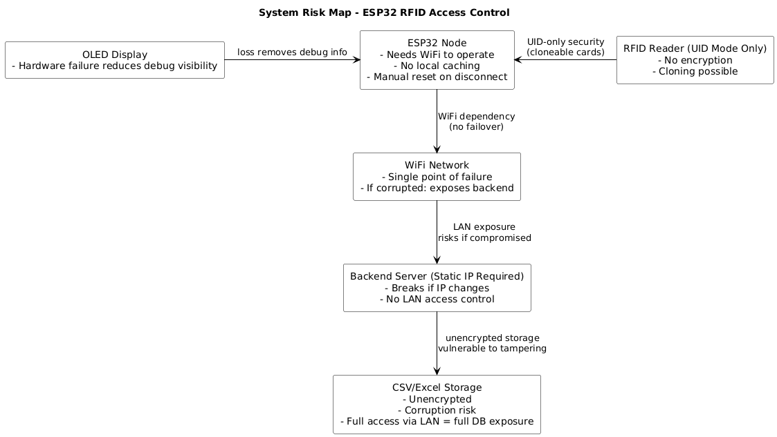
System Risks and Limitations
Potential Risks:
Security vulnerabilities in RFID technology.
Dependence on network connectivity.
Scalability limitations with the current architecture.
Limitations:
Limited user interface functionality.
Lack of advanced security features (e.g., intrusion detection).
System Risk Map: (Placeholder for: System Risk Map.png)

Slide 15

Conclusion and Reflection
Key Findings:
The project successfully integrates hardware and software components to create a functional RFID Access Control System.
The system demonstrates the application of software engineering principles and best practices.
Reflections:
The project provided valuable experience in system design, implementation, and testing.
Collaboration and communication were essential for project success.
Lessons Learned:
Importance of thorough planning and documentation.
Need for continuous learning and adaptation.

Slide 16
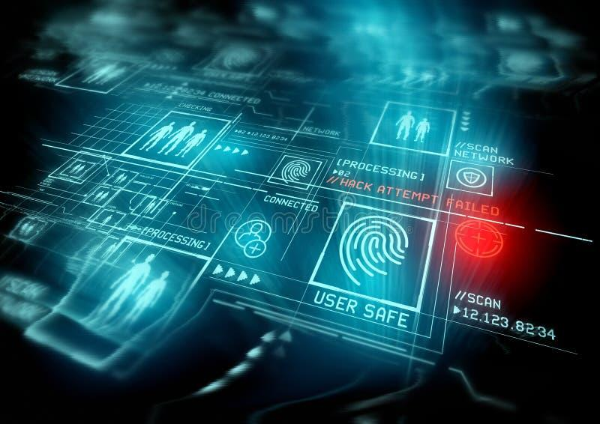
Future Improvements
Enhancements
Implement advanced security features (e.g., encryption, intrusion detection).
Improve user interface functionality and design.
Integrate with other systems (e.g., building management).
Enhance scalability and performance.
Implement Over-The-Air (OTA) updates.

Slide 17

Q&A Session
Questions?
This is the time to ask any questions you may have about the project.

Slide 18

Thank You Slide
Gratitude:
Thank you for your attention and engagement.
Feel free to connect for further discussion.
Email: y_belgha@concordia.ca
GitHub: github.com/Silent0Wings

